Slide 1
GENE SET PATHWAY MERGING AND ANALYSIS FOR ZTTK
Niko Dalla Noce, Alessandro Ristori, Andrea Zuppolini
Computational Health Laboratory Project
16/05/2022

Slide 2
Development keypoints
Geneset expansion
Starting from the SON gene we have expanded our dataset querying BioGRID
We did pathway enrichment to associate the genes with the pathways they contribute to
Pathway enrichment
Network analysis
Several metrics have been deployed to analyze our resulting network
Biomarker identification
We extracted the most significant biomarkers using the degree of the nodes
Community detection
We have detected the communities using the Louvain algorithm
In the end, we compared the pathways in the communities we have found for the SON gene with the known relevant effect of the ZTTK syndrome
Community analysis

Slide 3

GENESET EXPANSION
DLC

Slide 4
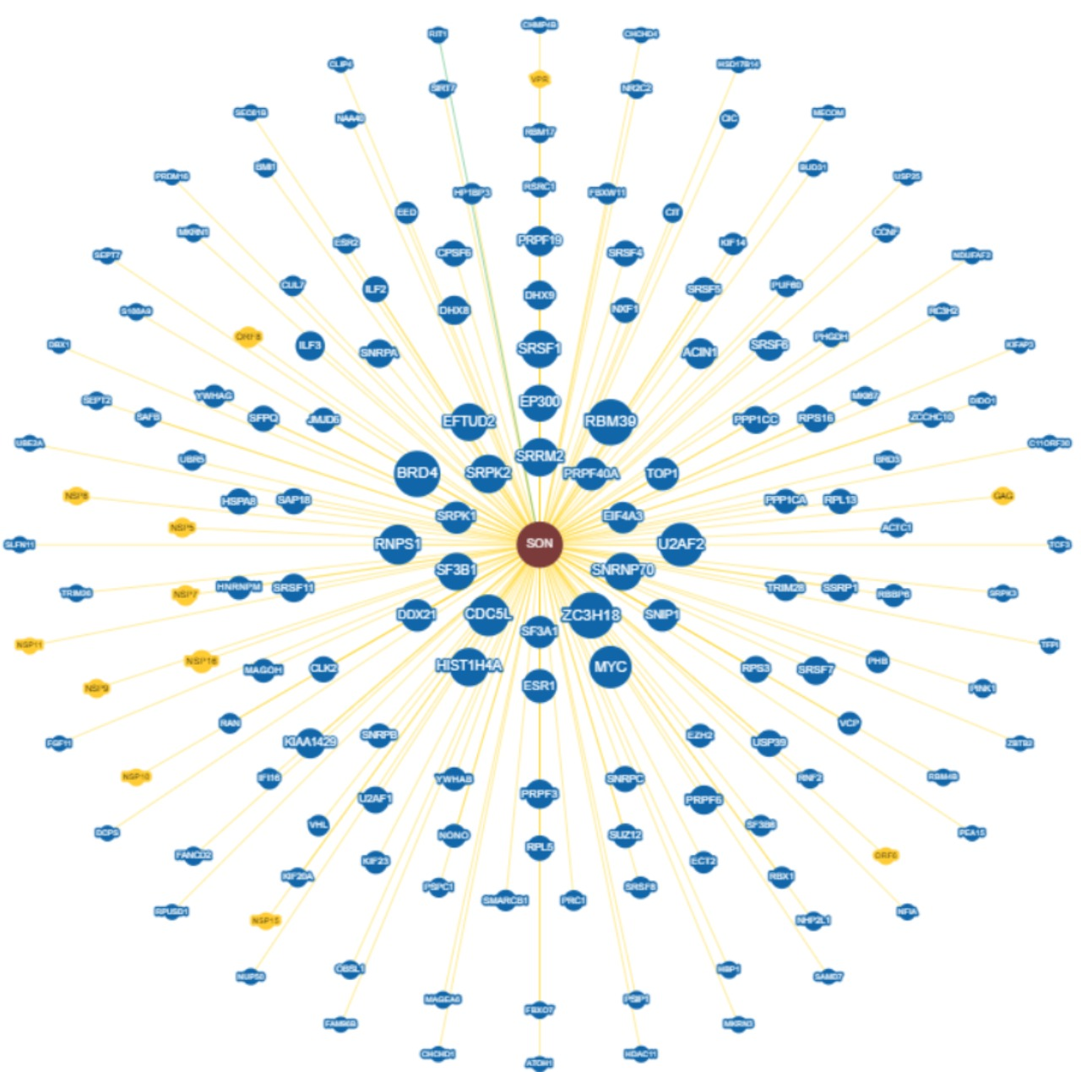
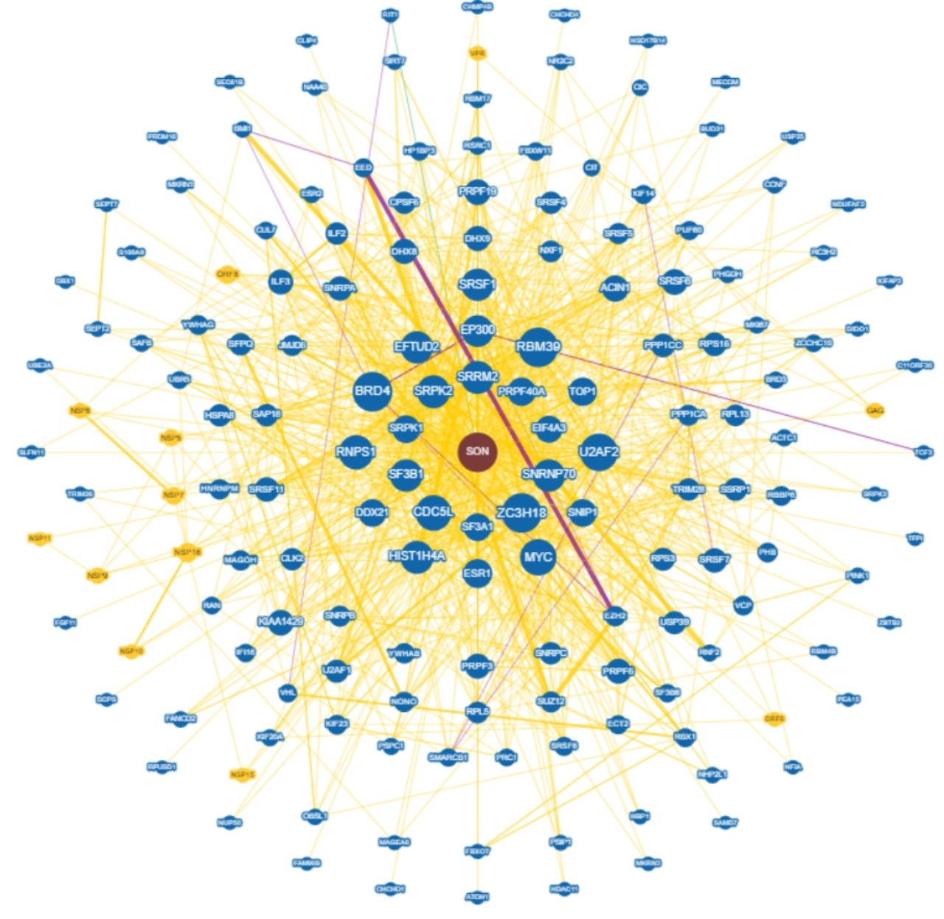
Geneset expansion
The 146 starting interactions
The interactions at the first order

Slide 5

PATHWAY ENRICHMENT

Slide 6


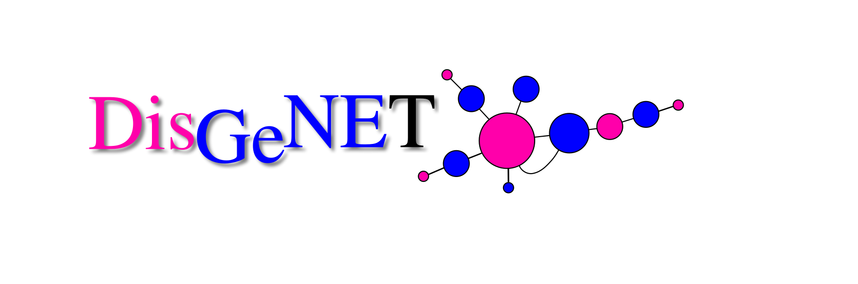
Pathway enrichment
Starting from the interactions dataset obtained at the end of the geneset expansion phase, we exploit the GSEApy package to perform pathway enrichment on the nodes linked to it:
First, we tried with the and human datasets with no success since we would have to manually remove all those pathways not related to any disease;
then we found the dataset, which satisfied our needs.
Using the dataset, we retrieved and filtered the disease pathways by keeping those having a p-value lower than 0.1, totaling 589 pathways.

Slide 7
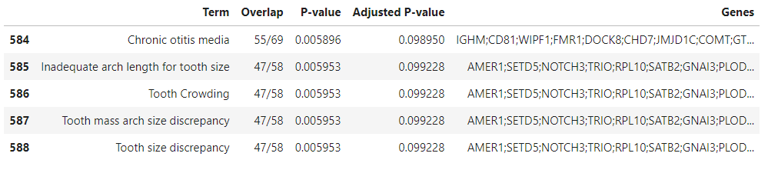
Disgenet
The GSEApy package, no matter the dataset, always returns a dataframe.
An example of disease pathways retrieved by using the GSEApy package.
Disease pathways retrieved by using the GSEApy package.

Slide 8

NETWORK
ANALYSIS

Slide 9

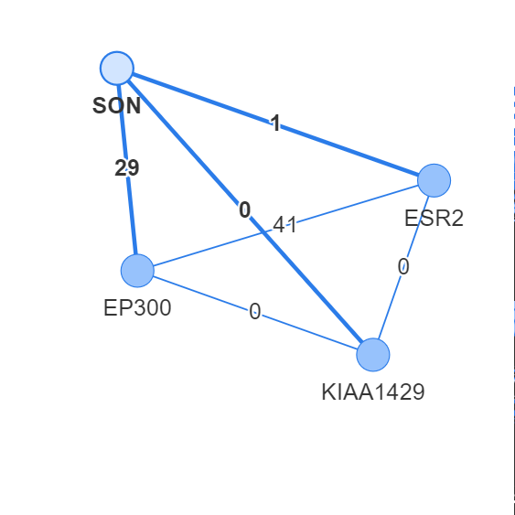
Network building
Starting from the interaction dataset built after the geneset expansion we developed our protein-to-protein network thanks to , a Python package for network analysis.

Slide 10
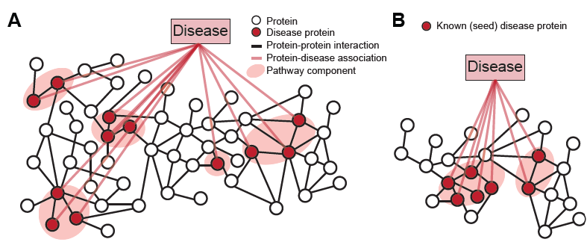
Protein network insight
A relevant number of nodes/proteins does not belong to any disease, more precisely 5101 of the 13010 proteins;
We decided to keep them since we did not want to end with possibly a non connected graph;
We observed that 45000 edge had no shared diseases between the couple of nodes they connect.

Slide 11
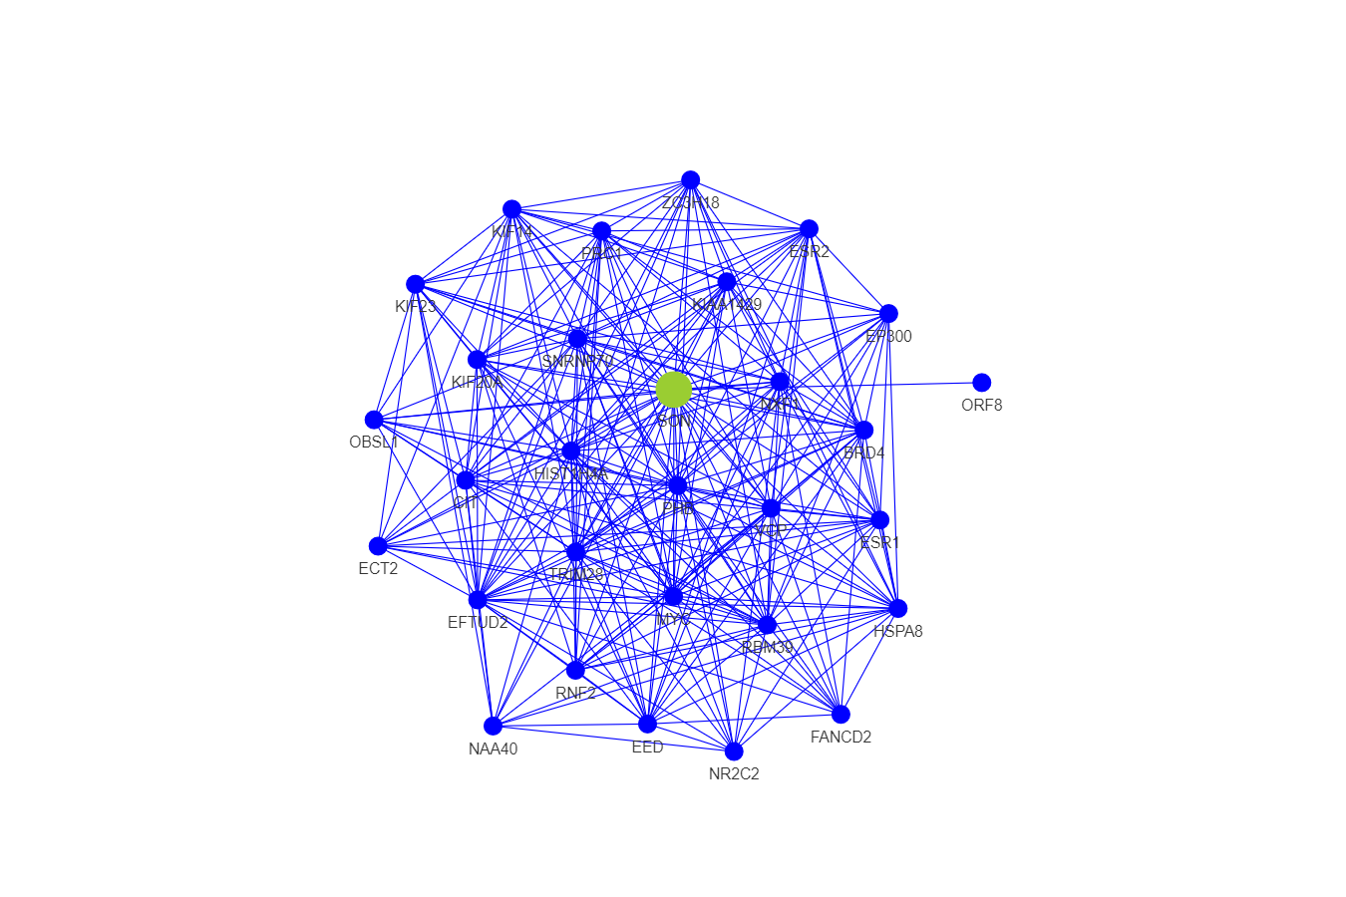
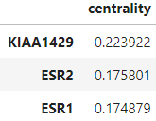
Biomarker identification
By using a centrality algorithm from networkx based on the nodes’ degree we extracted the biomarkers.
The centrality is the ratio between the node degree over the entire number of nodes that compose the graph.

Slide 12

COMMUNITY
ANALYSIS

Slide 13
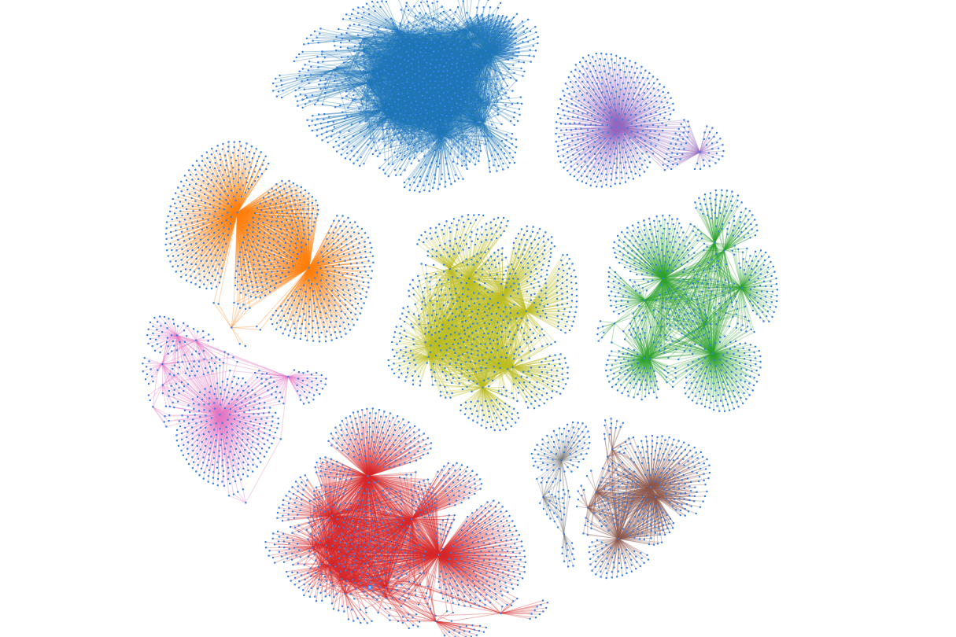
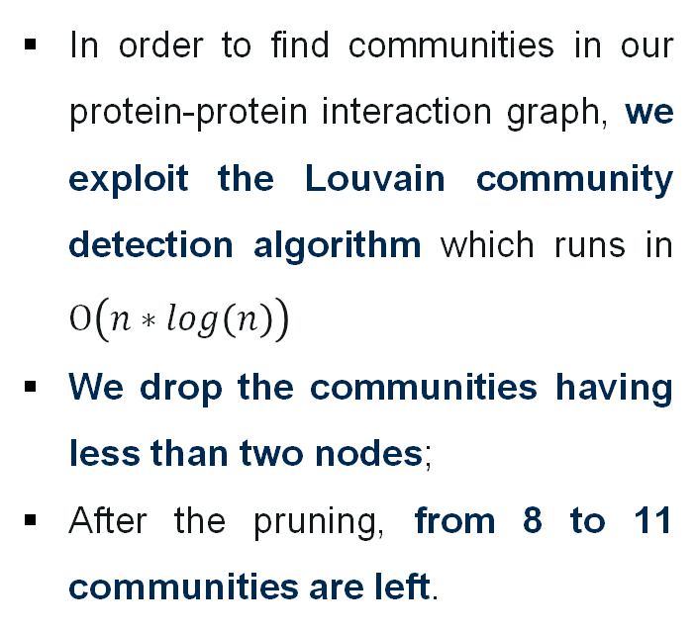
Community detection
In order to find communities in our protein-protein interaction graph, we exploit the Louvain community detection algorithm which runs in $Ο\left(n∗log\left(n\right)\right)$
We drop the communities having less than two nodes;
After the pruning, from 8 to 11 communities are left.
SON community

Slide 14

RESULTS

Slide 15
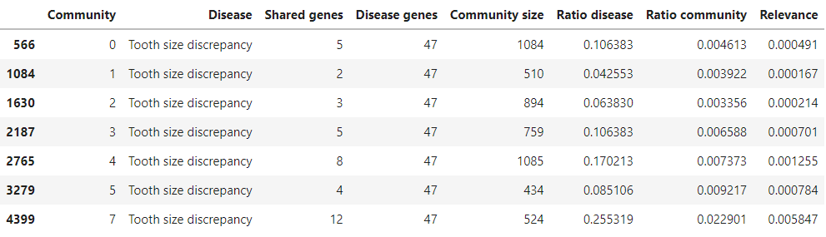
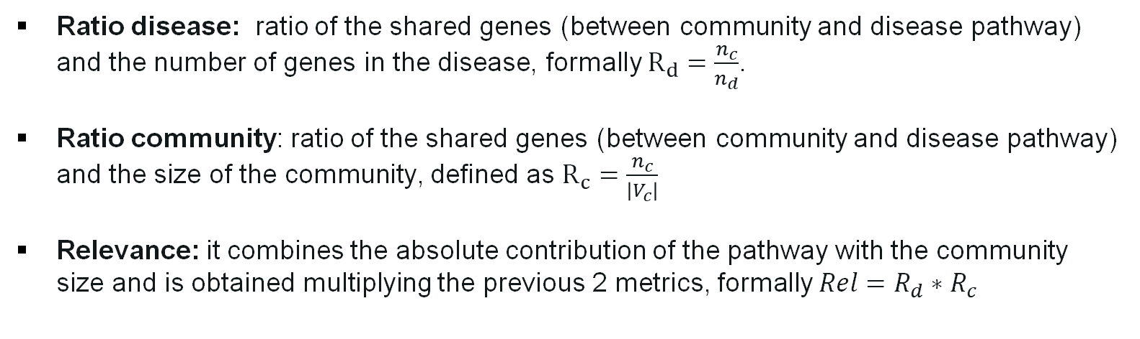
Community evaluation: metrics
Ratio disease: ratio of the shared genes (between community and disease pathway) and the number of genes in the disease, formally $R_{d}=\frac{n_{c}}{n_{d}}$.
Ratio community: ratio of the shared genes (between community and disease pathway) and the size of the community, defined as $R_{c}=\frac{n_{c}}{\left|V_{c}\right|}$
Relevance: it combines the absolute contribution of the pathway with the community size and is obtained multiplying the previous 2 metrics, formally $Rel=R_{d}∗R_{c}$

Slide 16
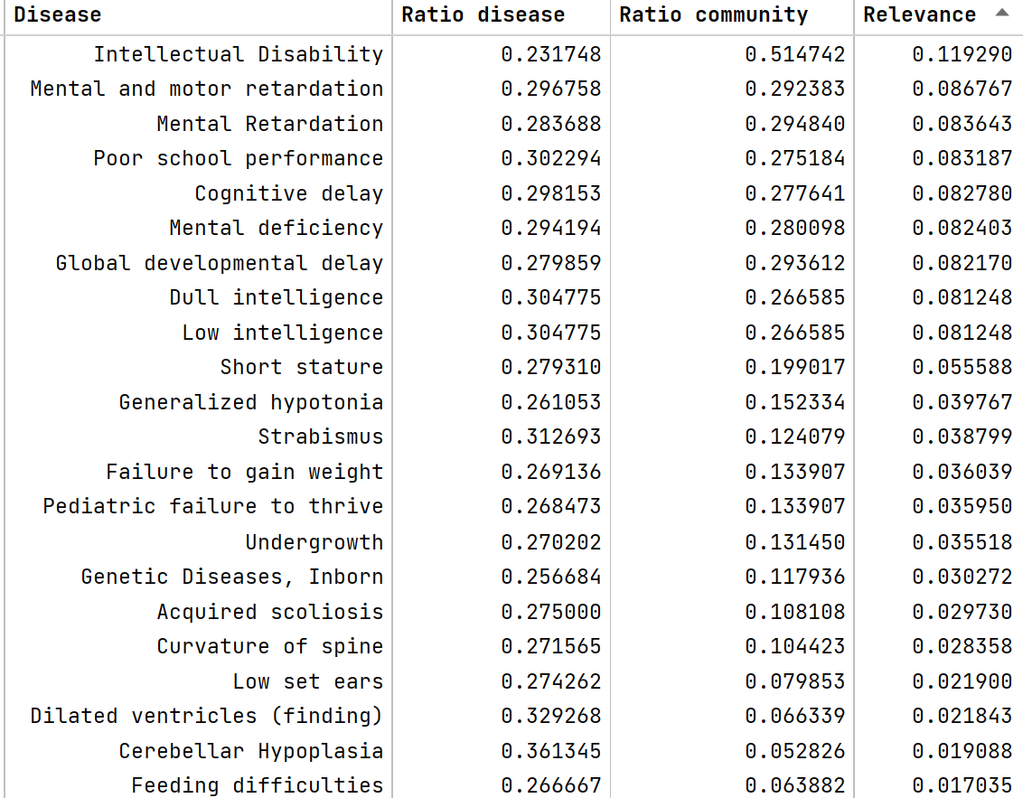
Relevant diseases in SON community
Diseases found in the SON community, ordered by Relevance.
Each disease contains SON in its pathway.

Slide 17
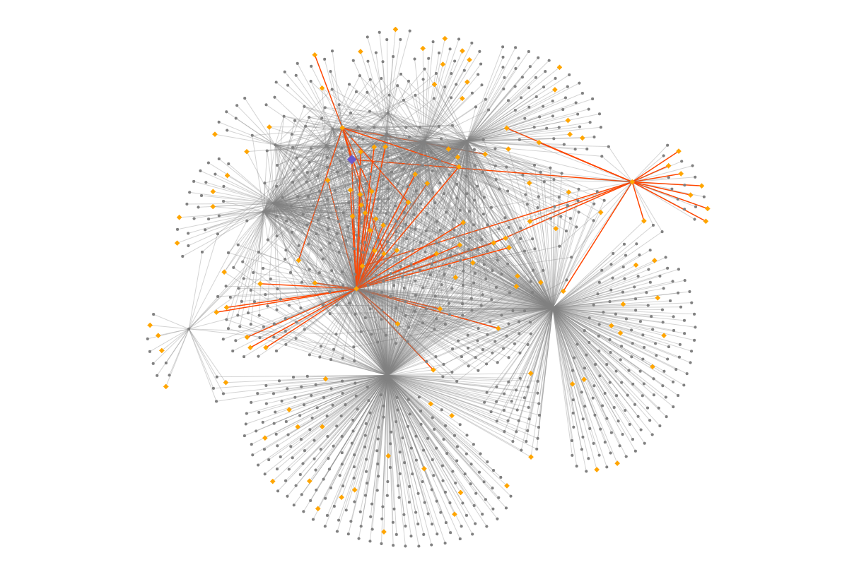
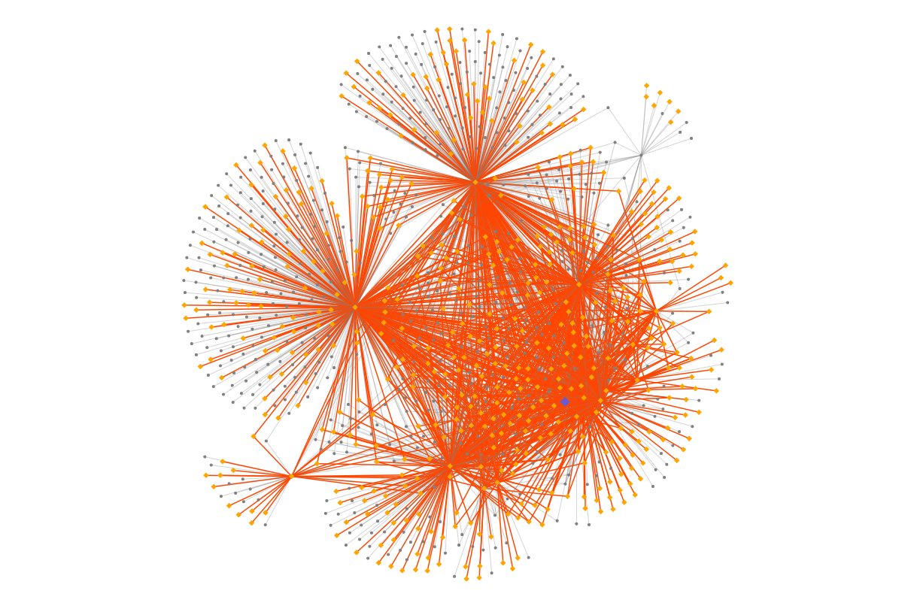
Relevant diseases in SON community
SON
SON
Intellectual disability disease
Undergrowth disease

Slide 18
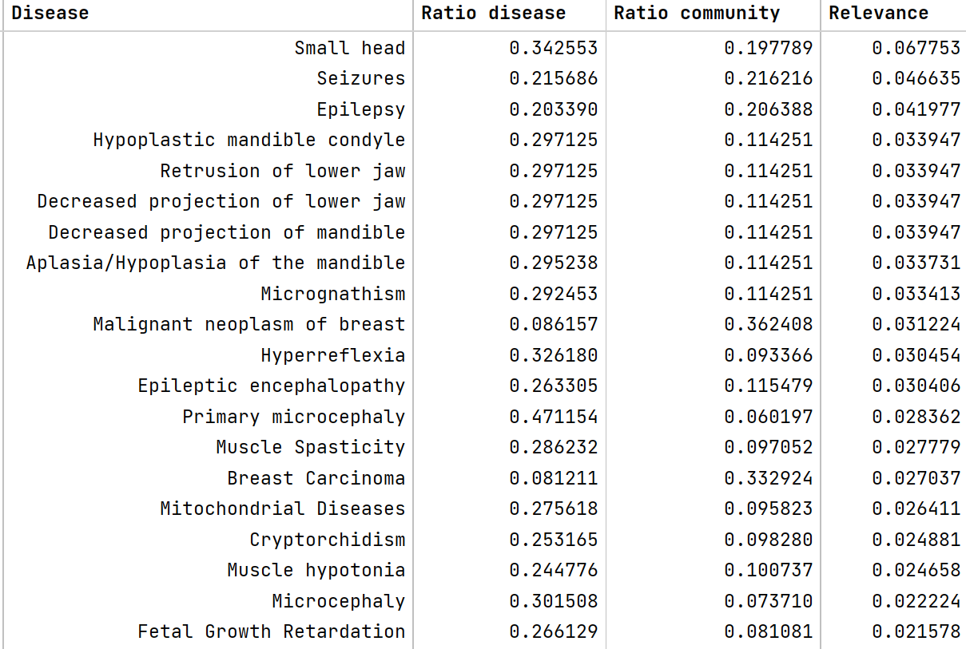
Relevant diseases in SON community
Diseases found in the SON community, ordered by Relevance.
SON is not inside any of those diseases, but some genes of their pathways interact with SON.

Slide 19
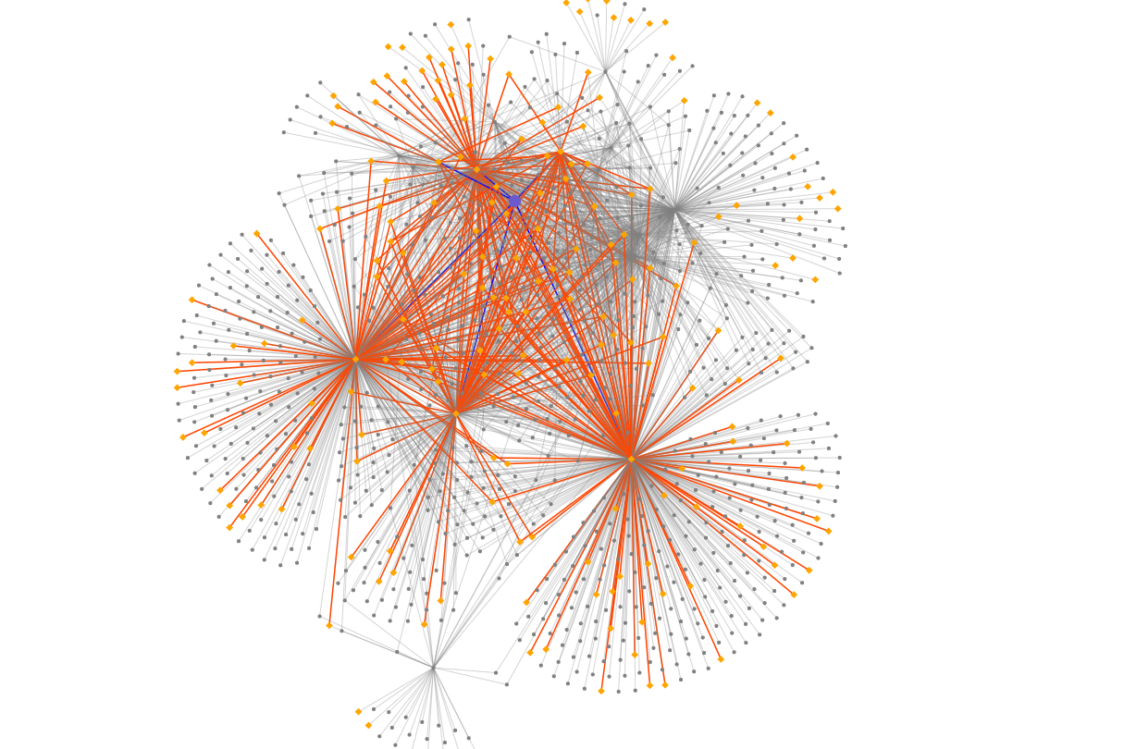
Relevant diseases in SON community
Genes interacting with SON:
Citron Rho-Interacting Serine/Threonine Kinas
Elongation Factor Tu GTP Binding Domain Containing 2
Histidine Triad Nucleotide-Binding Protein 5
Fanconi Anemia Complementation Group D2
SON
Small head disease

Slide 20
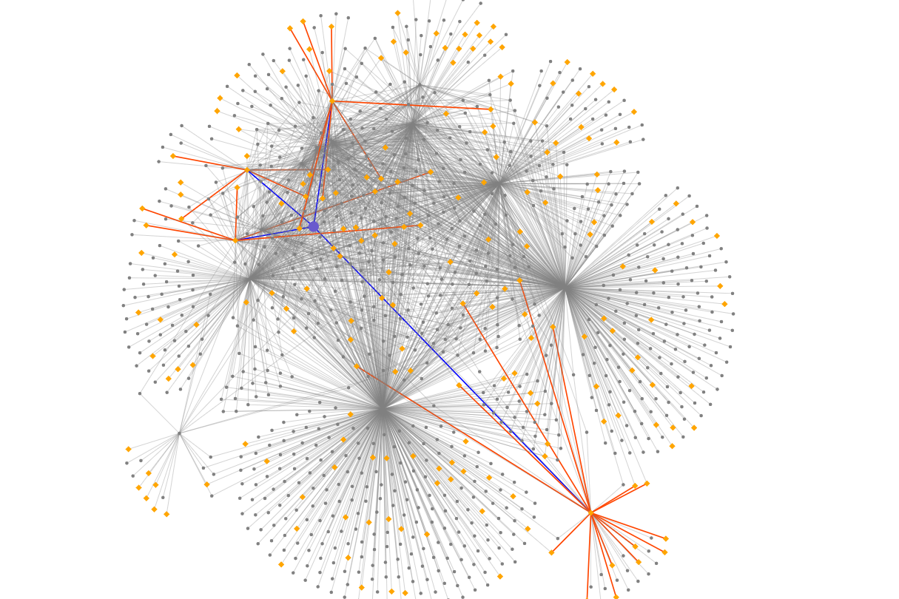
Relevant diseases in SON community
Genes interacting with SON:
Histone-Lysine N-Methyltransferase
Ubiquitin-Conjugating Enzyme E2A
Myc-Induced Mitochondrial Protein
SON
Epilepsy disease

Slide 21


